Slide 1


Noida Institute of Engineering and Technology, Greater Noida
ARM ARCHITECTURE FOR IoT
UNIT-III
OVERVIEW OF SOFTWARE LIBRARIES
Dr. Zatin Gupta
Associate Professor
B. Tech Fifth Semester
(Internet On Things)

Slide 2
Program Outcomes
1. Engineering knowledge: Apply the knowledge of mathematics, science, engineering fundamentals, and an engineering specialization for the solution of complex engineering problems.
2. Problem analysis: Identify, formulate, research literature, and analyse complex engineering problems reaching substantiated conclusions using first principles of mathematics, natural sciences, and engineering sciences.
3. Design/development of solutions: Design solutions for complex engineering problems and design system components or processes that meet the specified needs with appropriate consideration for public health and safety, and cultural, societal, and environmental considerations.
4. Conduct investigations of complex problems: Use research-based knowledge and research methods including design of experiments, analysis and interpretation of data, and synthesis of information to provide valid conclusions.
5. Modern tool usage: Create, select, and apply appropriate techniques, resources, and modern engineering and IT tools, including prediction and modeling to complex engineering activities, with an understanding of the limitations.
6. The engineer and society: Apply reasoning informed by the contextual knowledge to assess societal, health, safety, legal and cultural issues and the consequent responsibilities relevant to the professional engineering practice.
7. Environment and sustainability: Understand the impact of the professional engineering solutions in societal and environmental contexts, and demonstrate the knowledge of, and need for sustainable development.
8. Ethics: Apply ethical principles and commit to professional ethics and responsibilities and norms of the engineering practice.
9. Individual and team work: Function effectively as an individual, and as a member or leader in diverse teams, and in multidisciplinary settings.
10. Communication: Communicate effectively on complex engineering activities with the engineering community and with the society at large, such as, being able to comprehend and write effective reports and design documentation, make effective presentations, and give and receive clear instructions.
11. Project management and finance: Demonstrate knowledge and understanding of the engineering and management principles and apply these to one’s own work, as a member and leader in a team, to manage projects and in multidisciplinary environments.
12. Life-long learning: Recognize the need for, and have the preparation and ability to engage in independent and life-long learning in the broadest context of technological change.

Slide 3
Course Outcome
Course outcome: After completion of this course students will be able to
CO 1 | Describe ARM processor architectures. | K₁, K₂
CO 2 | Recognize ARM-based microcontrollers as modern IoT computing platforms. | K₁, K_{3,}
CO 3 | Realize Software design basics, software engineering principles. | K_{3,} K₄
CO4 | Explore Target Board FRDM-KL25Z for embedded system application. | K_{3,} K₄
CO 5 | Design smart IoT enabled devices using ARM. | K₂, K_{4,} K₅

Slide 4
ARM ARCHITECTURE FOR IoT |  |  |  |  |  |  |  |  | Year of Study: 2023-24
CO | PO1 | PO2 | PO3 | PO4 | PO5 | PO6 | PO7 | PO8 | PO9 | PO10 | PO11 | PO12
CO1 | 3 | 1 |  | 1 | 0 | 1 | 0 | 0 | 0 | 0 | 0 | 2
CO2 | 3 | 2 | 1 | 2 | 1 | 0 | 1 | 0 | 0 | 0 | 0 | 1
CO3 | 3 | 3 | 3 | 2 | 3 | 1 | 1 | 0 | 0 | 0 | 0 | 2
CO4 | 3 | 2 | 3 | 2 | 3 | 1 | 1 | 0 | 0 | 0 | 0 | 2
CO5 | 3 | 3 | 3 | 3 | 3 | 1 | 1 | 0 | 0 | 0 | 0 | 2
Average | 3 | 2.2 | 2.5 | 2 | 2 | 0.8 | 0.8 | 0 | 0 | 0 | 0 | 1.8

Slide 5
UNIT-III | OVERVIEW OF SOFTWARE LIBRARIES | 8 Hours
Mixed Assembly and C Programming, Digital Input and Output, GPIO Controller. Cortex Microcontroller Software Interface Standard (CMSIS), Introduction to MBED SDK for ARM, Introduction to Keil MDK and libraries for ARM. Embedded Development Kit, Analog Input and Output Overview, DAC, ADC, Analog IO.

Slide 6
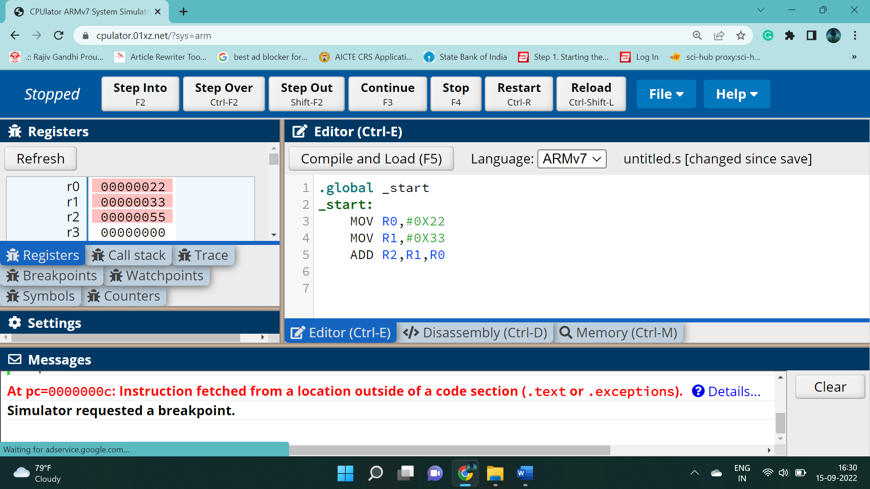
Assembly Language Programming
Addition of two numbers

Slide 7
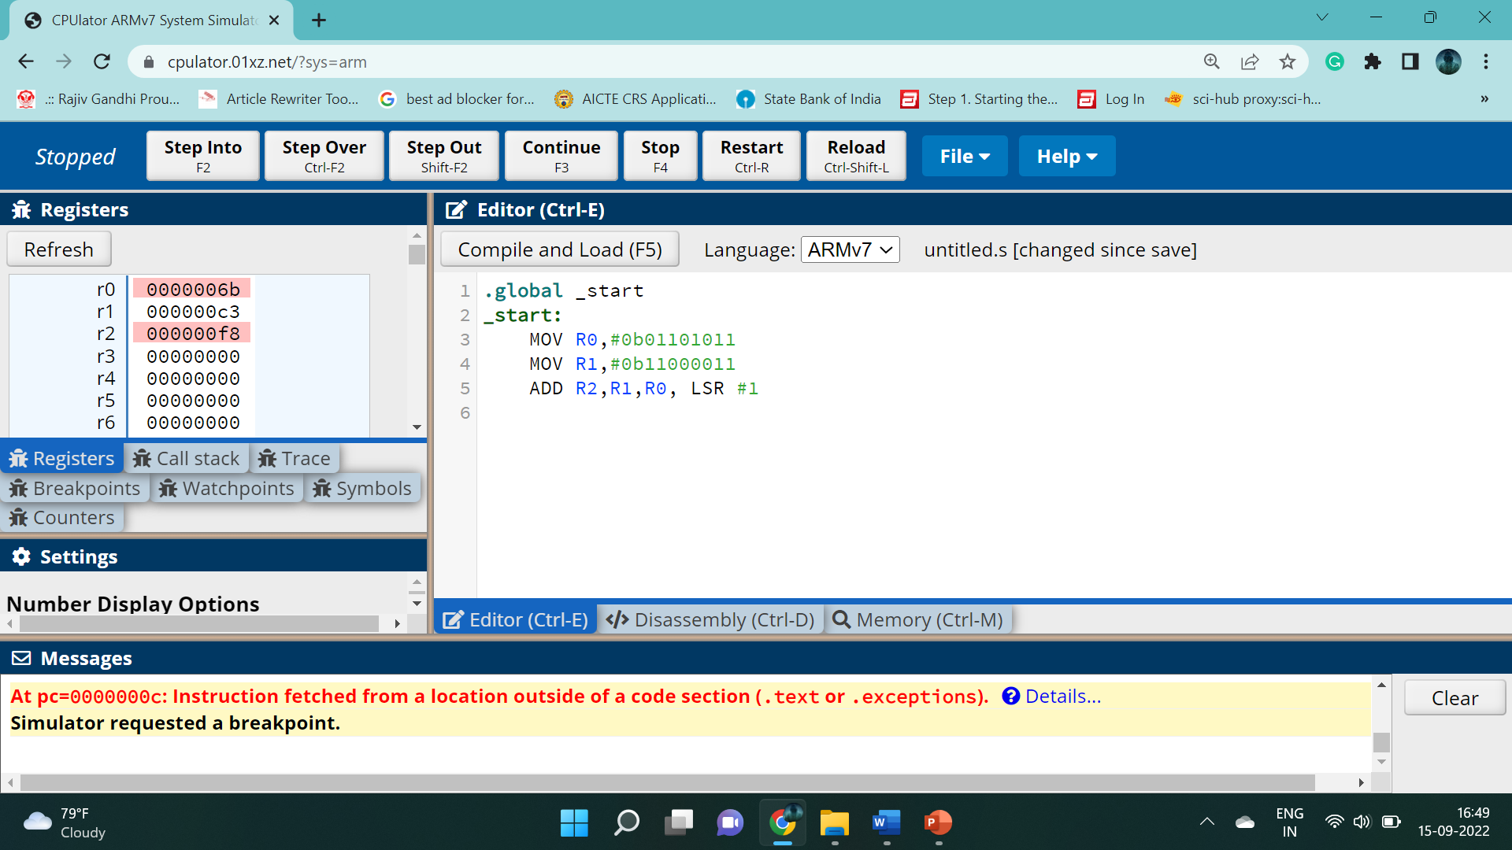
Assembly Language Programming
Addition of two numbers

Slide 8

Assembly Language Programming
Subtractor of two 8 bit numbers with logical shift.

Slide 9

Assembly Language Programming
Subtractor of two 8 bit numbers with logical shift.

Slide 10
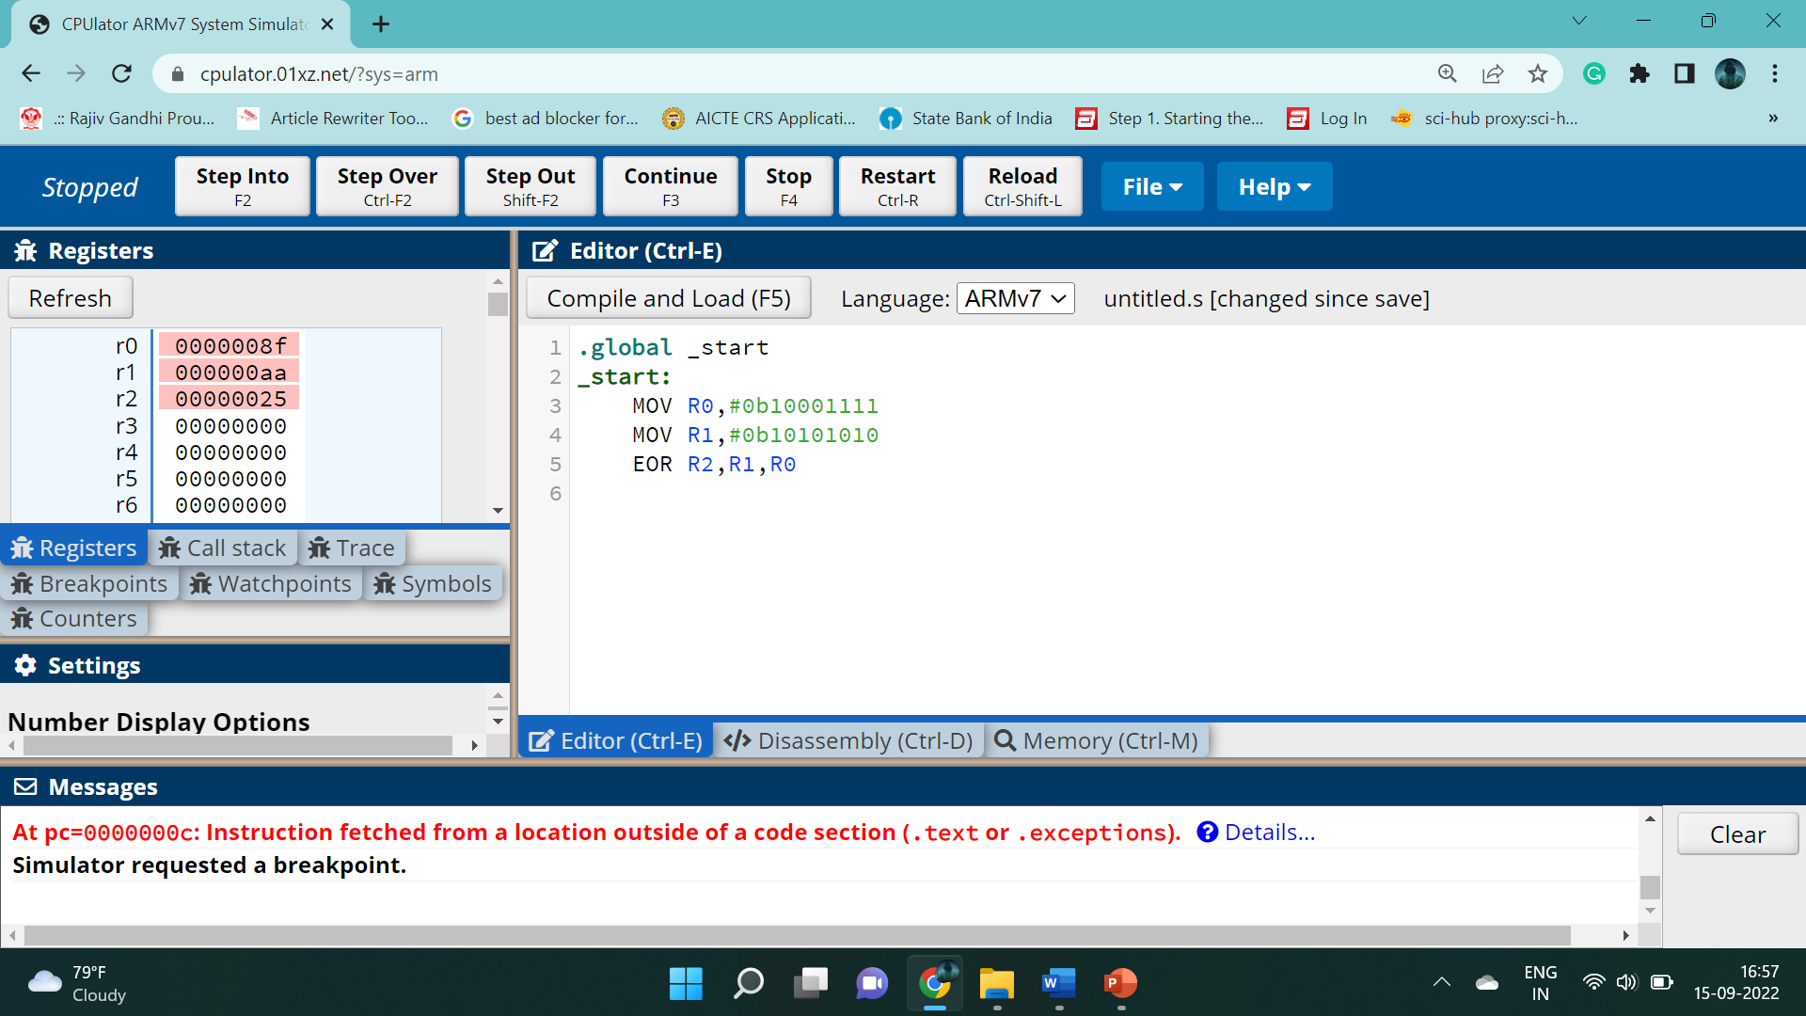
Assembly Language Programming
Logical XOR Operations using ALP of ARM Cortex

Slide 11
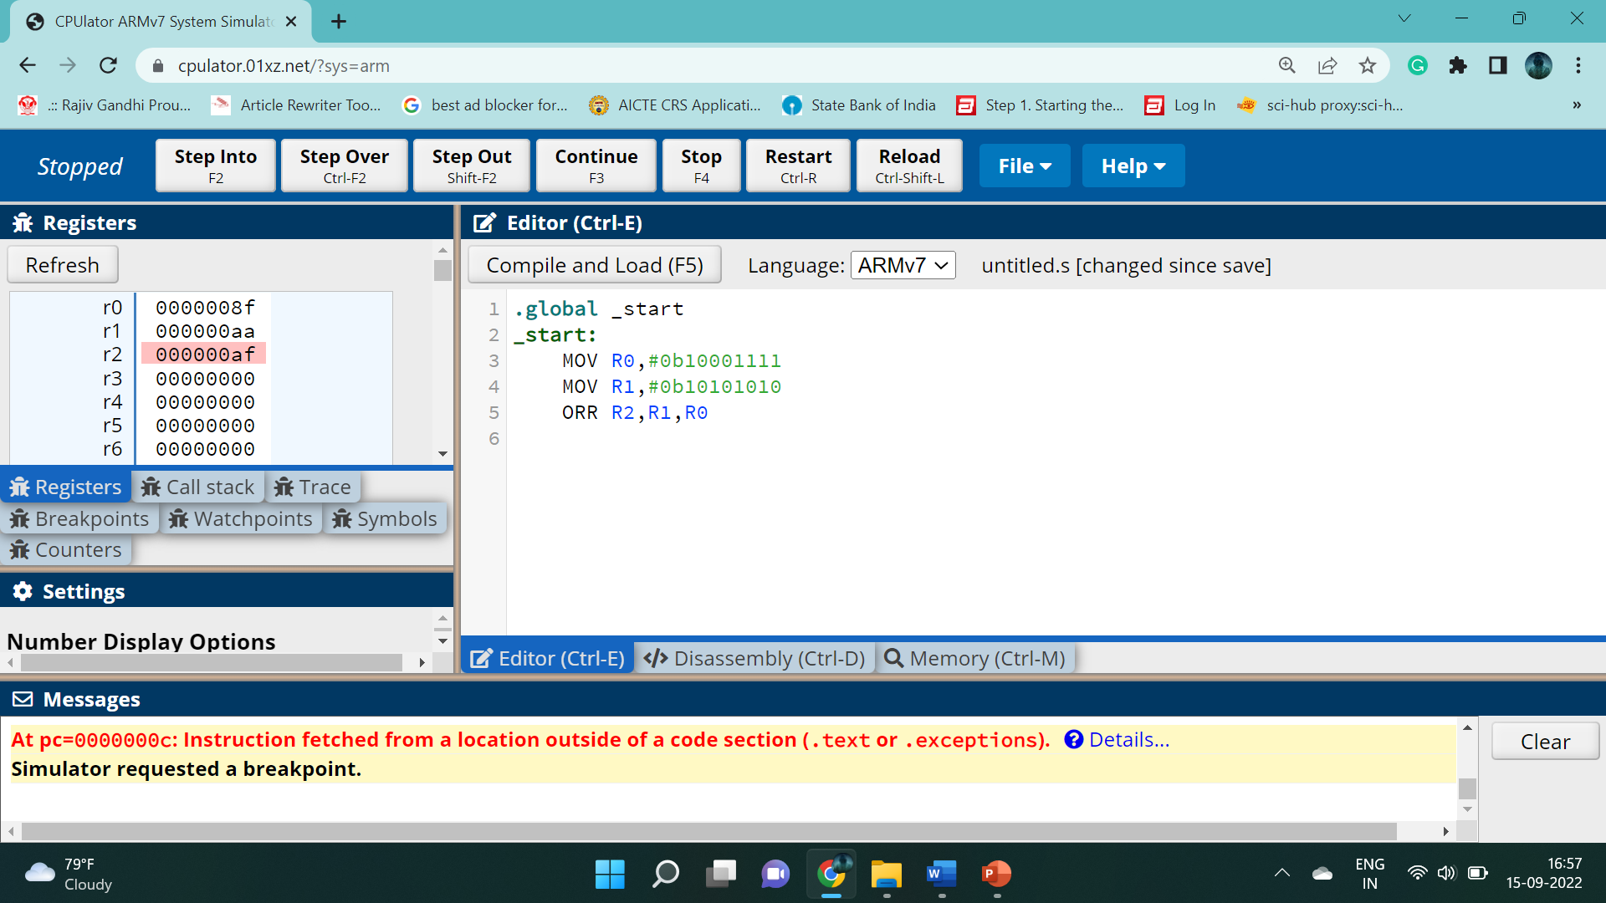
Assembly Language Programming
Logical OR Operation using ALP of ARM Cortex

Slide 12

Assembly Language Programming
Logical inverted AND Operation using ALP of ARM Cortex

Slide 13
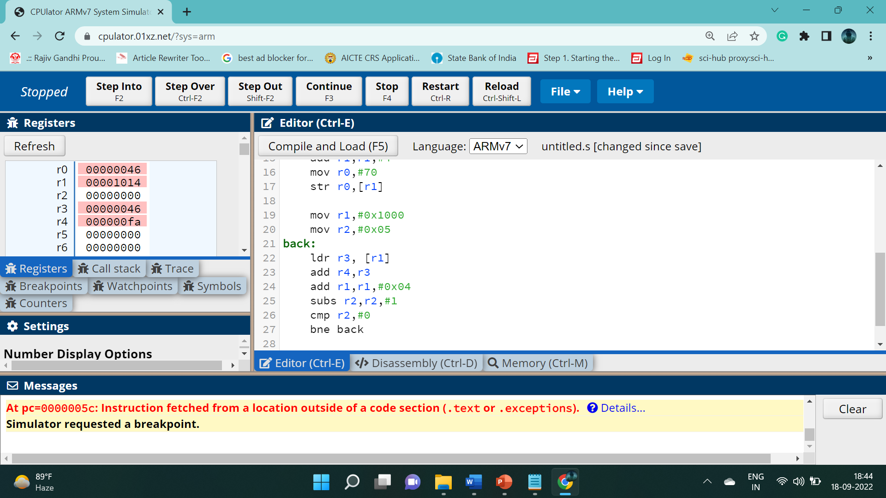
Assembly Language Programming
.global _start
_start:
mov r0,#30
mov r1,#0x1000
str r0,[r1]
add r1,r1,#4
mov r0,#40
str r0,[r1]
add r1,r1,#4
mov r0,#50
str r0,[r1]
add r1,r1,#4
mov r0,#60
str r0,[r1]
add r1,r1,#4
mov r0,#70
str r0,[r1]
mov r1,#0x1000
mov r2,#0x05
back:
ldr r3, [r1]
add r4,r3
add r1,r1,#0x04
subs r2,r2,#1
cmp r2,#0
bne back
Addition of five numbers located at memory stated from 0x1000.

Slide 14
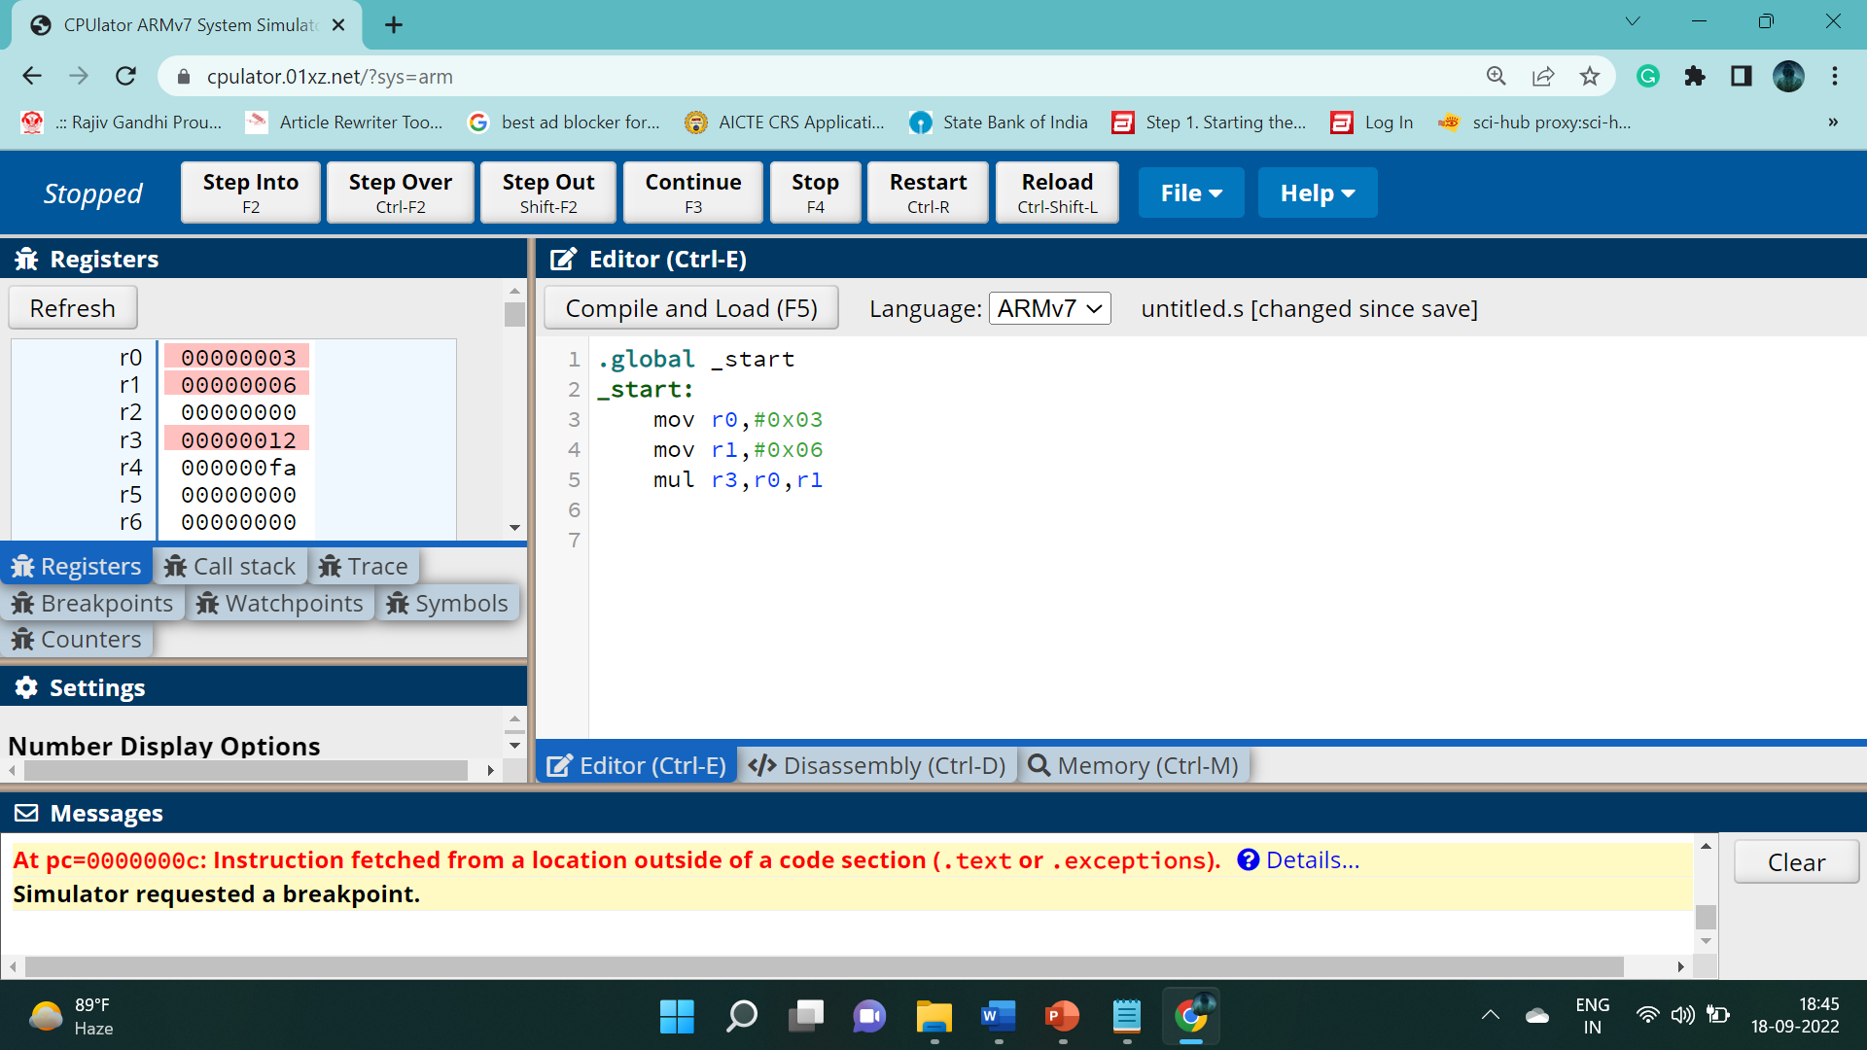
Assembly Language Programming
Multiplication of two numbers

Slide 15
Mbed-OS
The mbed is a SDK platform provides free software libraries, hardware designs and online tools for professional rapid prototyping of products based on ARM microcontrollers.
Arm Mbed OS is a free, open-source embedded operating system designed specifically for the “things” in the Internet of Things. It includes all the features you need to develop a connected product based on an Arm Cortex-M microcontroller, including security, connectivity, an RTOS, and drivers for sensors and I/O devices. Mbed OS is now a Thread Certified Component. Using IPv6 with 6LoWPAN as the foundation, Thread technology provides a low-power, self-healing mesh network designed for the home.

Slide 16
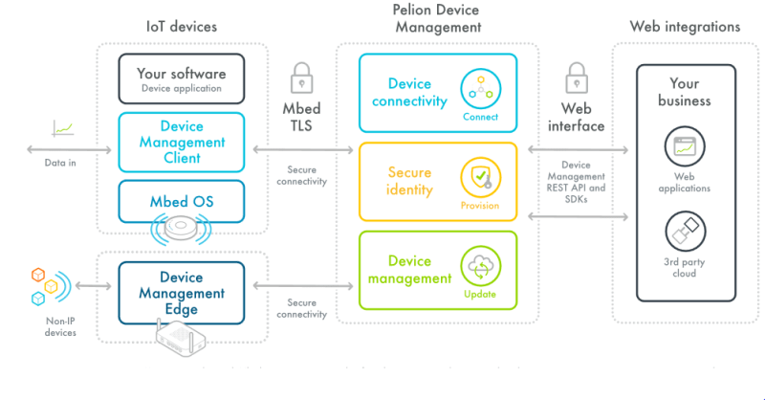
Mbed Working and flow diagram in IoT
Pelion Device Management provides the ability to efficiently and flexibly manage a wide range of IoT device profiles from constrained through to rich node or gateway.
Mbed OS Connectivity: A broad range of connectivity options are available in Mbed OS, supported with software libraries, development hardware, tutorials and examples. Bluetooth, Wi-Fi, 6LoWPAN Sub-GHz Mesh, NFC, Thread, LoRa, LPWAN, RFID, Ethernet, Cellular

Slide 17
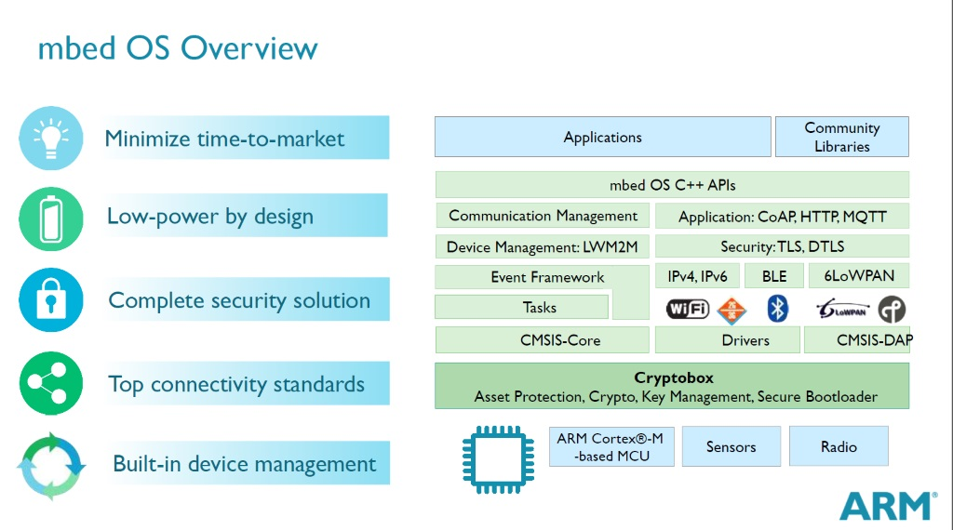

Slide 18
ARM mbed based C programming
Embedded C Code of LED interfacing on an ARM base Mbed Microcontroller board using the Mbed tool.
#include "mbed.h"
DigitalOut l1(p5);
DigitalOut l2(p6);
DigitalOut l3(p8);
int main() {
while (1) {
l1 = 1;
wait_ms(500);
l2 = 1;
wait_ms(500);
l3 = 1;
wait_ms(500);
printf("LED's are %d %d %d\n", l1.read(), l2.read(), l3.read());
l3 = 0;
wait_ms(500);
l2 = 0;
wait_ms(500);
l1 = 0;
wait_ms(500);
printf("LED's are %d %d %d\n", l1.read(), l2.read(), l3.read());
}
}

Slide 19
ARM mbed based Embedded C programming
#include "mbed.h"
DigitalOut led1(p5);
DigitalOut led2(p6);
DigitalOut led3(p8);
Ticker t1;
Timeout t2;
InterruptIn btn(p7);
void blink_led1() {
printf("Ticker fired\n");
led1 = !led1;
}
void toggle_led2() {
printf("BUTTON1 fall invoked\n");
led2 = !led2;
}
void turn_led3_on() {
printf("Timeout fired\n");
led3 = 1;
}
int main() {
printf("Hello world!\n");
printf("LED1 will blink every second, LED3 will toggle after 2.5 seconds, LED2 can be toggled through BUTTON1.\n");
printf("-----------------------------------\n\n");
t1.attach(callback(&blink_led1), 1.0f);
t2.attach(callback(&turn_led3_on), 2.5f);
btn.fall(callback(&toggle_led2));
wait_ms(osWaitForever);
}
Embedded C Code Interrupt using Switch and timer on an ARM base Mbed Microcontroller board using the Mbed tool. Perform following:-
LED1 will blink every second
LED3 will toggle after 2.5 seconds
LED2 can be toggled through BUTTON1

Slide 20
ARM Embedded C programming
#include "mbed.h"
#include "C12832.h"
C12832 lcd(SPI_MOSI, SPI_SCK, SPI_MISO, p8, p11);
int main() {
printf("Demo by NIET Students\n");
printf("NIET Grater NOIDA IOT bracnch -LCD\n");
int i, s;
lcd.cls();
lcd.set_auto_up(0);
lcd.locate(5, i);
lcd.printf("Happy");
lcd.locate(5, i + 12);
lcd.printf("DIWALI");
lcd.copy_to_lcd();
printf("Done!\n");
}
Write and compile Embedded C Code of graphics LCD (C12832) interfacing with ARM based Mbed Microcontroller board using the Mbed Studio tool.

Slide 21
ARM mbed based Embedded C programming
#include "mbed.h"
#include "C12832.h"
#include "Sht31.h"
C12832 lcd(SPI_MOSI, SPI_SCK, SPI_MISO, p8, p11);
Sht31 sht31(I2C_SDA, I2C_SCL);
DigitalOut led(LED1);
int main() {
printf("Set the temperature above 25 degrees to trigger the warning LED\n");
while (1) {
lcd.cls();
float temp = sht31.readTemperature();
float humidity = sht31.readHumidity();
lcd.locate(3, 3);
lcd.printf("Temperature: %.2f C", temp);
lcd.locate(3, 13);
lcd.printf("Humidity: %.2f %%", humidity);
// turn on LED if the temperature is above 25 degrees
led = temp > 25.0f;
wait(0.5f);
}
}
Write and compile Embedded C Code for interfacing temperature and humidity sensor (SHT31) with ARM based Mbed Microcontroller board using the Mbed Studio tool.

Slide 22
ARM mbed based Embedded C programming
#include "mbed.h"
PwmOut speaker(p21);
void play_tone(float frequency, float volume, int interval, int rest)
{
speaker.period(1.0 / frequency);
speaker = volume;
wait(interval);
speaker = 0.0;
wait(rest);
}
int main()
{
while(1) {
play_tone(200.0, 0.5, 1, 0);
play_tone(150.0, 0.5, 1, 0);
play_tone(125.0, 0.5, 1, 2);
}
}
Write and compile Embedded C Code for interfacing Speaker using ARM based Mbed Microcontroller board using the Mbed Studio tool. Play different frequency tones on speaker.

Slide 23
ARM mbed based Embedded C programming
Write and compile code of IR Sensor interfacing and for target board KL25Z. Use mbed library.
IR sensor connected on Port-B pin 3. and LED’s are connected on PTB4, PTB5, PTA11 and PTA8.
#include "mbed.h"
DigitalIn IR(PB_3);
BusOut leds(PB_4, PB_5, PA_11, PA_8);
int main()
{
IR.mode(PullNone);
while(1) {
printf("IR has value of %d \n", IR.read());
if (IR.read() == 0) {
leds = 0xff;
printf("leds are ON \n");
} else {
leds = 0x00;
printf("leds are OFF \n");
}
}
}

Slide 24
ARM mbed based Embedded C programming
Write and compile code of Proximity (PIR) Sensor interfacing and for target board KL25Z. Use mbed library.
PIR sensor connected on Port-B pin 3. and LED is connected on PTB4.
#include "mbed.h"
InterruptIn PIR(PB_3);
DigitalOut myled(PB_4);
int PIR_Detected = 0;
void irq_handler(void){
PIR_Detected = 1;
}
int main(){
PIR.rise(&irq_handler);
while(1) {
if (PIR_Detected) {
myled = 1;
PIR_Detected = 0;
wait(1);
}
else {
myled = 0;
wait(2); //for warming up time
}
}
}

Slide 25
ARM mbed based Embedded C programming
#include "mbed.h"
DigitalOut myled(PB_4);
InterruptIn sensor(PB_3);
Serial pc(USBTX, USBRX);
int NbTopsFan;
int Calc;
void rpm() //This function increments on the rising edge of the hall effect sensors signal
{
NbTopsFan++;
}
int main() {
while(1) {
NbTopsFan = 0; //Set NbTops to 0 ready for calculations
myled=1;
sensor.rise(&rpm); //Enables rising edge interrupt
wait_ms(1000); //Wait 1 second and count HALL pulses
sensor.rise(NULL); //Disable interrupt
myled=0;
Calc = (NbTopsFan * 60) / 7.5; //(Pulse frequency x 60) / 7.5Q, = flow rate in L/hour
pc.printf ("Flow L/hour: %d\r\n",Calc); //Prints the number calculated above
}
}
Write and compile code of Waterflow sensor interfacing and for target board KL25Z. Use mbed library.
Waterflow sensor connected on Port-B pin 3. and LED is connected on PTB4.

Slide 26
ARM Embedded C programming without mbed
#include <MKL25Z4.h>
#include <math.h>
void delay(int n){
int i;
for(i=0;i<n;i++);
}
int main()
{
SIM->SCGC5 |=0x0400;
PORTB->PCR[18]=0x0100;
PTB->PDOR =0x40000;
PTB->PDDR =0x40000;
while(1){
PTB->PCOR=0x40000;
delay(5000000);
PTB->PSOR=0x40000;
delay(5000000);
}
}
Write and compile code of LED interfacing and debug the program image on an KL25Z board using the Keil MDK-ARM tool.

Slide 27
ARM Embedded C programming without mbed
#include <MKL25Z4.h>
#include <math.h>
void delay(int n){
int i;
for(i=0;i<n;i++);
}
int main()
{
SIM->SCGC5 |=0x0400;
PORTB->PCR[18]=0x0100;
PTB->PDOR =0x0000000F;
PTB->PDDR =0x0000000F;
while(1){
PTB->PCOR=0x00000005;
delay(5000000);
PTB->PSOR=0x0000000A;
delay(5000000);
}
}
Write and compile code of DC Motor interfacing and debug the program image on an KL25Z board using the Keil MDK-ARM tool.

Slide 28
ARM Embedded C programming without mbed
Write and compile code of PWM based Servo motor interfacing for target device KL25Z board, Without mbed library. Servo Connected on Port-B pin 18.
#include "MKL25Z4.h"
#define PTB18_Pin 18
#define PTB18_PWM_Ch 0
#define MASK(x) (1 << (x))
void init_PWM(void)
{
SIM_SCGC5 |= SIM_SCGC5_PORTB_MASK;
PORTB->PCR[PTB18_Pin] &= ~PORT_PCR_MUX_MASK;
PORTB->PCR[PTB18_Pin] |= PORT_PCR_MUX(3);
SIM->SCGC6 |= SIM_SCGC6_TPM2_MASK;
SIM->SOPT2 &= ~SIM_SOPT2_PLLFLLSEL_MASK;
SIM->SOPT2 |= SIM_SOPT2_PLLFLLSEL(0); // MCGFLLCLK
TPM2->MOD = 7500;
}
int main(void)
{
init_PWM();
TPM2_C0V = 0x8000;
while(1)
{}
}

Slide 29
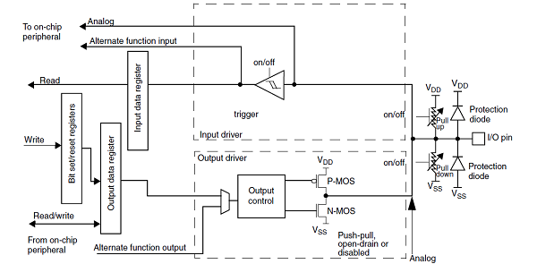
GPIO controller

Slide 30
GPIO controller
The GPIO peripheral is used to configure the device IO ports as:
Either input or output from External devices
Either read or write from external memory
Either Analog or digital signaling
Either filtered or non filtered
Either high power or low power signaling using pull-up
Every GPIO pin of FRDM-KL25z (ARM) can be analog or digital, all GPIO pins can also generate PWM, all GPIO pins can also filter inputs, all GPIO pins can also boost current and all pins can also connect with pull up register for multiplexed output. On the other hand In Arduino there are different pins for digital, different pins for analog, different pins for PWM, different pin for high and low power.

Slide 31

Cortex Microcontroller Software Interface Standard (CMSIS)
Cortex Microcontroller Software Interface Standard (CMSIS) technology is dedicated to help software engineers creating program codes for any Cortex-M based microcontroller in the fastest and most reliable way.
As soon as all drivers, libraries and middleware are carefully created by ARM and silicon vendors and verified by ARM, it can guarantee that startup code and MCU peripheral configuration code will be generated correctly.

Slide 32
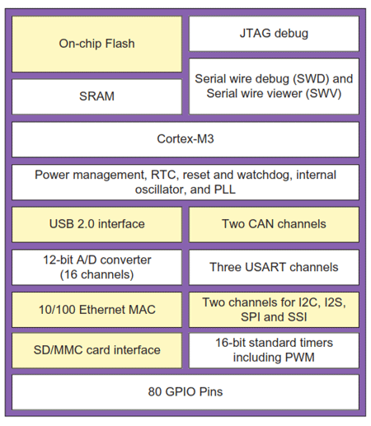
Need of CMSIS
A vast 'cloud' of standard microcontrollers with increasingly complex peripherals as well as typical microcontroller peripherals such as USART, I2C, ADC, and DAC.
A modern high-end microcontroller could well have a HostDevice USB controller, Ethernet MAC, SDIO controller, and LCD interface.
The software to drive any of these peripherals is effectively a project in itself, so gone are the days of a developer using an 8-bit microcontroller(like Arduino) and writing all of the application code from the reset vector.
Cortex-based microcontrollers can have a number of complex peripherals on a single chip. To make these work you will need to use some form of third-party code.
CMSIS is intended to allow stacks from different sources to integrate together easily.
Cortex-based microcontrollers uses CMSIS

Slide 33
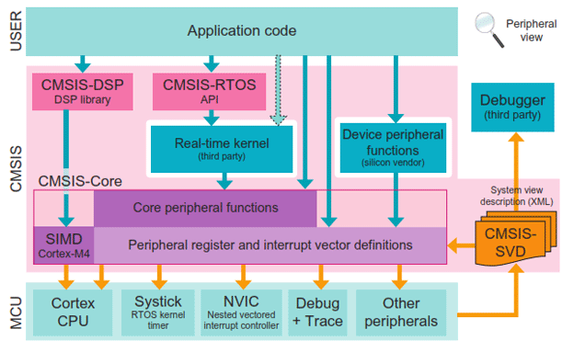
CMSIS Specifications and Module
CMSIS Layers architecture
The main aim of CMSIS (Cortex Microcontroller Software Interface Standard) is to improve software portability and reusability across different microcontrollers and toolchains.
This allows software from different sources to integrate seamlessly together. Once learned, CMSIS helps to speed up software development through the use of standardized software functions.
CMSIS consists of a several separate specifications (CORE, DSP, RTOS, SVD, and DAP) that make source code more portable between tools and devices

Slide 34
CMSIS MODULES
CMSIS Core: The core specification provides a minimal set of functions and macros to access the key Cortex-M processor registers.
CMSIS RTOS: The CMSIS RTOS specification provides a standard API for an RTOS. This is in effect a set of wrapper functions that translate the CMSIS RTOS API to the API of the specific RTOS that you are using.
CMSIS DSP: The Cortex-M4 is a 'digital signal controller' with a number of enhancements to support Digital Signal Processing (DSP) algorithms.

Slide 35
CMSIS MODULES
CMSIS-SVD: CMSIS-SVD is included in CMSIS-Pack. It supports microcontroller detailed views to the device peripherals which displays the current register state with system view description (SVD) format.
CMSIS-DAP: CMSIS-DAP is an integrated tool that uses standardized interface to the Cortex debug access port (DAP) and is also used by several starter and development kits.

Slide 36
Introduction to Keil MDK
The MDK-ARM (Microcontroller Development Kit) is the complete software development environment(SDE) for ARM7 , ARM9 , Cortex -M, and Cortex-R4 processor-based devices.
MDK is specifically designed for microcontroller applications and combines the ARM C/C++ Compiler with the Keil RTX real-time operating system and middleware libraries.
All tools are integrated into µVision which includes project management, editor and debugger in a single easy-to-use environment.
The fully integrated ARM C/C++ Compiler offers significant code-size and performance benefits to the embedded developer, however, MDK can also be used with the GNU GCC Compiler

Slide 37
Keil-MDK Modules

Slide 38
MDK Tools
The MDK Tools include all the components that you need to create, build, and debug an embedded application for ARM based microcontroller devices.
MDK-Core consists of the genuine Keil μVision IDE and debugger with leading support for Cortex-M processor-based microcontroller devices
MDK includes two ARM C/C++ Compilers with assembler, linker and highly optimize run-time libraries.
DS-MDK contains the Eclipse-based DS-5 IDE and debugger and offers multi-processor support for devices based on 32-bit Cortex-A processors

Slide 39
MDK-Software Packs
Software packs contain device support, CMSIS libraries, middleware, board support, code templates, and example projects.
They may be added any time to MDK-Core or DS-MDK, making new device support and middleware updates independent from the toolchain.
The IDE manages the provided software components that are available for the application as building blocks.

Slide 40
libraries for ARM
The ARM C libraries provide standard C functions, and helper functions used by the C and C++ libraries.
The C libraries also provide target-dependent functions that implement the standard C library functions such as printf in a semi-hosted environment. The C libraries are structured so that you can redefine target-dependent functions in your own code to remove semi-hosting dependencies.
The ARM libraries comply with:
the C Library ABI for the ARM Architecture (CLIBABI)
the C++ ABI for the ARM Architecture (CPPABI).

Slide 41
Embedded Development Kit
The Embedded Development Kit (EDK) is an integrated development environment for designing embedded processing systems.
Like for ARM Cortex M series we have:
FRDM-KL25z EDK
STM32 EDK
NUCLEO-L152RE

Slide 42
Analog-to-digital converters (ADC)
Analog-to-digital converters are widely used in data acquisition. Basically, an ADC converts analog signal into digital signal.
This is required because in the physical world we live every quantity we interact with is analog in nature.
By physical quantities, mean quantities like temperature, humidity, weight, velocity pressure etc.
However, digital computers use discrete or binary values only, this brings us to transducers.
A transducer is a device used to convert physical quantities to electrical signal i.e. voltage and current.
When this transducer is used to generate output then it is known as sensor.
Hence we have temperature sensor, pressure sensor, humidity sensor and so on.

Slide 43
ADC on FRDM-KL25Z
FRDM-KL25z has 6 channels (A0,A1,A2,A3,A4 and A5) of 16 bit-Analog to Digital Convertor(ADC).
ADC sensitivity when Aref voltage is 5V
5/2^16=0.0000763 V = 76.3 microV
Hence after 76.3 microV change in analog input will cause one bit change in digital output.
For example if input voltage is 1.5 Volt then its digital output will be
1.5/0.0000763=> 19659 (decimal) => 0100110011001011 (binary)

Slide 44
digital-to-analog converter
In electronics, a digital-to-analog converter (DAC) is a system that converts a digital signal into an analog signal.
DACs are commonly used in music players to convert digital data streams into analog audio signals. They are also used in televisions and mobile phones to convert digital video data into analog video signals.

Slide 45
DAC on FRDM-KL25Z
KL25z has one 12bit Digital to Analog Convertor(DAC)
Here the Vdd decides the analog value,
For example if Vdd is 5 volt then.
DAC sensitivity will be of :-
5/2^12= 0.00122 volt= 1.22 mili-volt(mV)
Every one binary bit change cause 1.22 mV change in analog output.
Digital | Analog
000000000000 (0) | 0V (0x1.22mV)
000000000001 (1) | 1.22mV (1x1.22mV)
000000000010 (2) | 2.44mV (2x1.22mV)
…. | …..
000000001111 (15) | 18.3mV (15x1.22mV)
101011111111 (2815) | 3.4343 V (2815x1.22mV)

Slide 46
Sample MCQ
1. Which of the following is the professional kit? a) PK52 b) CA51 c) A51 d) PK51
2. Which of the following is the Compiler kit? a) CA51 b) PK51 c) A51 d) A52
3. Does PK51 support extended memory derivatives? a) True b) False
4. _______ is a complete line of home IoT devices that includes smart switches. a) Awair b) Canary c) Belkin’s WeMo d) Cinder
5. _______ is the best for Internet connected thermostat. a) Honeywell b) GE connected appliances c) Eversense d) Nest

Slide 47
Thank You

